Slide 1
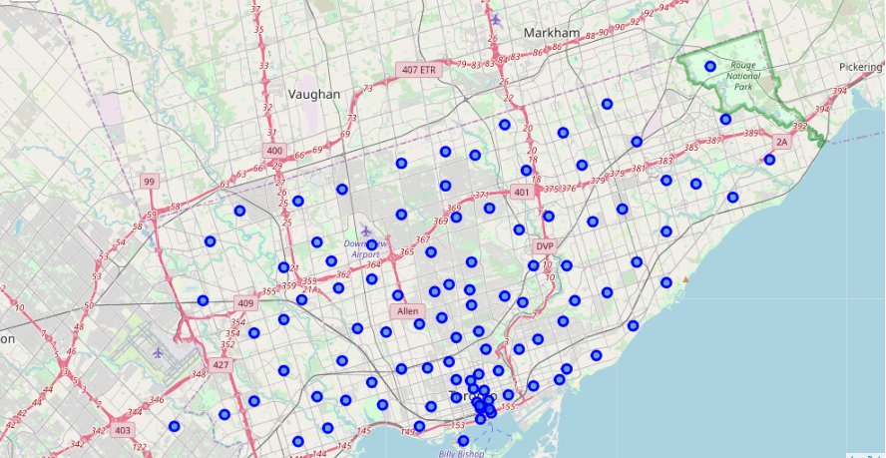
Best place for a Summer trip in Central Toronto

Slide 2

Business problem
A travel agent conducted a survey to help them plan a trip for a group of students from Stellenbosch University to visit Toronto. In the survey, the agent asked the students what facilities and activities they’d like to do while in Canada. The results in the survey showed that the students prefer to stay in Central Toronto.
The agent then sent results of the survey to our consulting company (StervAI) to analyse the results and recommend boroughs to get the students accommodation in Central Toronto

Slide 3
Data requirements
The data required for this project include:
Geo-coordinates for the recreational activities, amenities and facilities gathered by the travel agent in the survey
Geo-coordinates for borough and neighborhoods in Central Toronto
locational information about that specific borough and the neighborhoods in that borough

Slide 4
Data requirements – survey results
Activities, amenities and facilities prefer to be in close proximity to include the following matches in FOURSQUARE API:
'Zoo Exhibit','Zoo','Park','Dessert Shop','Burger Joint','Campground','Hakka Restaurant','Coffee Shop’,
'Fried Chicken Joint','Sandwich Place','Italian Restaurant','Chinese Restaurant','BBQ Joint','Steakhouse',
'Golf Course','Liquor Store','Sports Bar','Food & Drink Shop','Pub','Beach','Pharmacy','Sporting Goods Shop',
'Supermarket','Arts & Crafts Store','Grocery Store','Toy / Game Store','Breakfast Spot','Noodle House',
'Community Center','Ice Cream Shop','Fast Food Restaurant','Bookstore','Gym','American Restaurant','Tea Room',
'Cosmetics Shop','Wings Joint','Sushi Restaurant','Seafood Restaurant','Gym / Fitness Center','Fish & Chips Shop',
'Restaurant','Pizza Place','Bistro','Smoothie Shop','African Restaurant','Thai Restaurant','Hotpot Restaurant',
'Café','History Museum','Clothing Store','Gastropub','Indie Movie Theater','Discount Store','Shopping Mall',
'Bagel Shop','Other Great Outdoors','Movie Theater','Playground','General Entertainment','Gourmet Shop',
'Comic Shop','Farmers Market','Beer Bar','Burrito Place','Cocktail Bar','Historic Site','French Restaurant',
'Trail','Taco Place','Diner','Skating Rink','Bubble Tea Shop','Auto Dealership','Shopping Plaza','Food','Road',
'New American Restaurant','Rock Climbing Spot','Hobby Shop','Furniture / Home Store',
'Paper / Office Supplies Store','Deli / Bodega','Health Food Store','Ski Chalet','Hardware Store',
'Recreation Center','Garden','Electronics Store','Department Store','Juice Bar','Museum','Food Court','Bar','Theater',
'Snack Place','Soup Place','Train Station','Theme Park','Theme Park Ride / Attraction','Shoe Store',
'Chocolate Shop','Tapas Restaurant','Organic Grocery','Whisky Bar','Comedy Club','Nightclub',
'Convenience Store'

